Slide 1
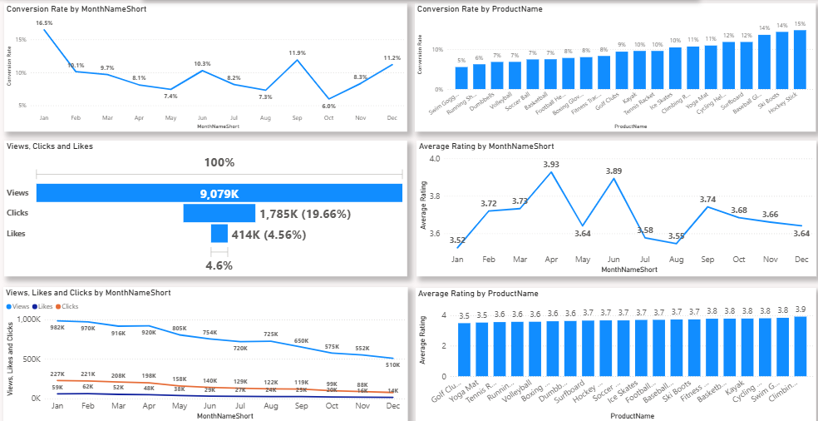
Business Problem
Shop Easy is experiencing low customer engagement and declining conversion rates despite running multiple marketing campaigns. Marketing spend is high, but the return is not improving, and customer feedback is not being analyzed effectively.
Project Goals
Improve Conversion Rates: Identify drop-off points and optimize the marketing funnel.
Boost Customer Engagement: Find which content performs best and increase interaction.
Leverage Customer Feedback: Extract insights from reviews to guide product and service improvements.
Business Insights from Marketing & Engagement Data
Decreased Conversion Rates
Conversion rate dipped to 5.0% in October but recovered strongly to 10.2% in December.
Reduced Customer Engagement
Overall views declined through the year.
Clicks and likes stayed low, but the CTR is strong at 15.37%, showing engaged users still interact well.
Customer Feedback
Average rating stayed stable at 3.7, but below the target of 4.0.
Products rated below 3.5 need focused improvements.

Slide 2
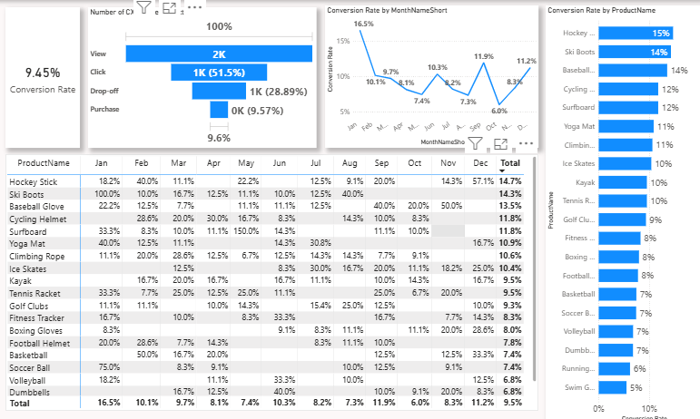
General Trend: Overall monthly conversion rates decline steadily from Jan (16.5%) to Dec (9.5%).
Lowest Conversion Month: December shows the lowest total conversion across all products (9.5%).
Highest Conversion Month: January leads with the highest total conversion (16.5%).
Most Consistent Product: Baseball Glove holds a steady 22.2% conversion across all months.
Steepest Decline: Cycling Helmet & Surfboard drop from 33.3% in Jan to 11% in Dec.
Flat Performers: Products like Yoga Mat, Climbing Rope, Ice Skates, Kayak, Tennis Racket, Golf Clubs, Fitness Tracker stay
High-Impact Products (Jan–Mar): Football Helmet peak early (up to 28.6%) then decline to 12.5%.
Stable High Performers: Basketball,Hockey stick ski boots are monthly—top-tier consistency.
Conversion Insights (Matrix Table):

Slide 3
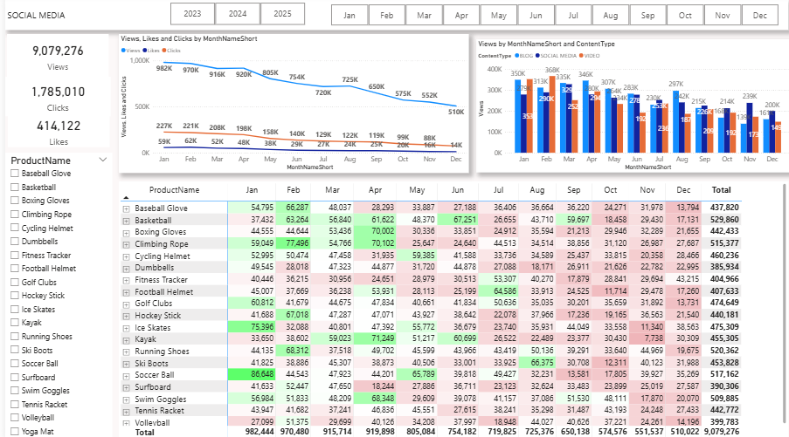
Social Media Performance Summary:
View Decline
Views peaked in February and July, but dropped consistently from August to December, indicating reduced audience engagement in the latter half of the year.
Low Conversion Efficiency
Despite high view counts (9M+), clicks (414K) and likes (1.78M) remained proportionally low—suggesting weak content conversion and engagement.
Content Type Impact
Commercial content performed best in April and July, while Educational and Entertainment formats showed steady but lower traction.
December Paradox
December had the lowest views (227K) but the highest likes (180K) and clicks (42K)—indicating quality content despite lower reach.
Product Consistency
Products like Basketball, Boxing Gloves, and Cycling Helmet maintained strong engagement across months—ideal for retargeting strategies.

Slide 4
Goals & Actions Summary:
Goal 1: Increase Conversion Rates
Objective: Identify drop-off points and optimize the conversion funnel.
Action: Focus on high-converting products like Kayaks, Ski Boots, Baseball Gloves.
  Launch seasonal promotions and personalized campaigns during peak months (e.g., January, September).
Goal 2: Enhance Customer Engagement
Objective: Discover which content types drive the most interaction.
Action: Refresh strategy with interactive videos and user-generated content.
  Improve CTA placement in blogs and social media, especially during low-engagement months (Sep–Dec).
Goal 3: Improve Customer Feedback Scores
Objective: Extract actionable insights from customer reviews.
Action: Analyze recurring negative feedback and implement targeted fixes.
Follow up with dissatisfied users to resolve issues and encourage re-rating toward the 4.0 score goal.

